Slide 1
Project Meeting
2019.04.26

Slide 2
Flow Chart of Working Architecture
Cloud
LoRaWAN
WiFi, Ethernet
LoRa Sensor node ( Raspberry Pi 3 )
LoRa Gateway ( Raspberry Pi 3 )
LoRa
Antenna
(SX1276)
LoRa
Antenna
(SX1276)
Receiver
Packet Forwarding program
LoRa transmission.py
LoRa receipt.py
Message
Management program
Smart meter
Simulator.py
Smart meter Dataset.csv
DNN
container
BC
container

Slide 3
Issue
After integrated Receiver, the container cannot receive data from host.
Sol:
Check the container can receive the data from host is work.
Running the flow again.

Slide 4
Cloud (Using Google Cloud Platform)
Components (Current progress) under esl-iot-registry
Cloud IoT Core
Cloud Pub/Sub
Next to do:
Setup Cloud Database
Subscribe data from available topics in our system then save to database
Prepare local server to subscribe topics (as a backup data – if needed)
Notes:
Registry created to enable protocol such as MQTT or HTTP

Slide 5
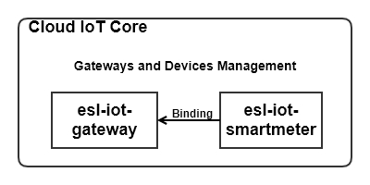
Cloud IoT Core
Notes:
Currently, we setup for one gateway, can add another gateway later

Slide 6
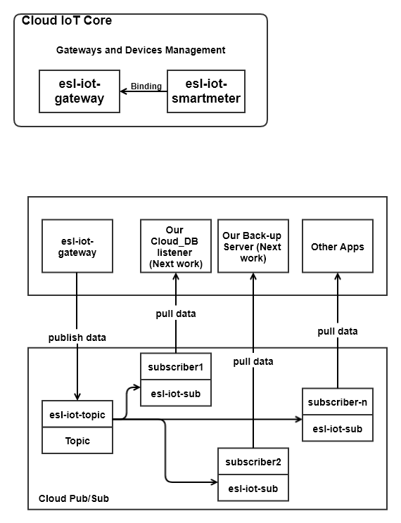
Cloud Pub/Sub

Slide 7
Cloud Database
Component
Dataflow (to manage data stream from topic to database)
Cloud Storage (database space)
BigQuery (Manage table of dataset for further use)

Slide 8
Flow of Data
Google Pub/Sub
Stream (job)
Dataflow
BigQuery
Data table

